Slide 1
Breakthrough Innovation: The Critical Role of Management Control Systems
Marc J. Epstein
Nice, France
October 1, 2015

Slide 2
Making Innovation Work provides three new, important perspectives for senior managers
Innovation, like many business functions, is a management process that requires specific tools, rules and discipline—it is not mysterious.
Innovation requires the right measurement and rewards to deliver sustained, high yields.
3. Companies can use innovation to grow, hold their own against powerful competitors, or even to redefine an industry by employing combinations of business model innovation and technology innovation.

Slide 3
Metrics and Motivators as Change Agents
Organization Structure
Leadership
Metrics and
Motivators
Culture
Learning Organization

Slide 4
THE SIX LEVERS OF INNOVATION
Value Proposition
(What?)
Products and Services
(Products)
Business Model Innovation
Technology
Innovation
Supply
Chain
(How?)
Process Technologies
(Processes)
Target Customer
(Who?
Enabling Technologies
(Enablers)

Slide 5
So, why do successful companies so often get left behind?
Notes:
This is we are going to explore in the next day and half. We are going to look at this issue and see how it applies at the company level, organization level, and individual level. As part of this program we are going to look at the things you can do in your role to present this kind of fate happening to Apple.

Slide 7
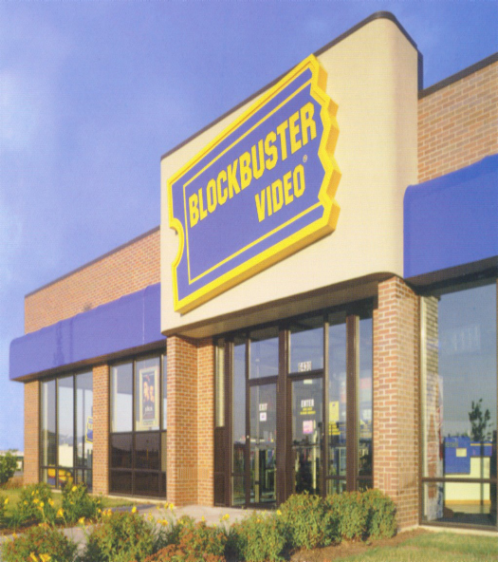

Slide 10
Ultimately they stopped…
Playing to win

Slide 11
Playing to Win
Playing Not to Lose
Being out in front
Protecting your current position
Breakthrough innovations & incremental improvements
Incremental improvements
“All in” on multiple fronts
Limiting your exposure

Slide 12
Technology
Business Model / Process

Slide 13
Playing to Win is a continuum

Slide 14
How do you know if you are really playing to win?

Slide 15
You need to test for...

Slide 16
Organizational Antibodies

Slide 17
Such as…
“That could cannibalize our existing products.”

Slide 18
General Motors EV1 (1996-1999)

Slide 19
“If the Mac company were a separate company, and the iPad company were a separate company, what would the Mac company build to compete with the iPad? And I think the answer is the MacBook Air."

Slide 20
“Our customers aren’t asking for that.”

Slide 21
"If I'd asked my customers what they wanted, they'd have said a faster horse."
- Henry Ford

Slide 22
“We don’t have the time or the resources.”

Slide 23
“We’ve been successful, why risk it?”

Slide 24
“We’ve always done it this way.”

Slide 25
“That could cannibalize our existing products.”
“Our customers aren’t asking for that.”
“We don’t have the time or the resources.”
“We’ve been successful, why risk it?”
“We’ve always done it this way.”

Slide 26
Ultimately there is a failure of imagination that blinds an organization to potential game changers.

Slide 27
In our work on breakthroughs we focused on the
barriers to breakthrough innovation
how to overcome them and succeed at developing and implementing breakthrough products and services

Slide 28
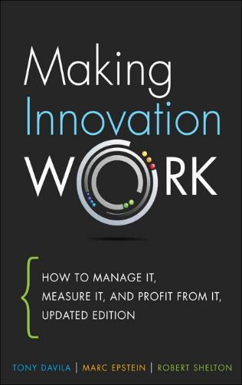

Slide 29
Operational excellence and incremental innovation succeed as long as the industry follows the predicted path.
All industries see breakthrough changes that make existing strategies obsolete.
At these points, what made companies great can become their largest liability.

Slide 30
Types of Innovation
Semi-radical
innovation
Radical
innovation
Ignorance
management
New
Incremental
innovation
Semi-radical
innovation
Technology change
Close to existing
Knowledge
management
Close to existing
New
Business model change

Slide 31
Breakthrough innovation deals with much higher levels of uncertainty and risk, and lower levels of knowledge.
Thus, it needs to be managed differently from incremental innovation.

Slide 32
Incremental innovation operates with relatively low levels of uncertainty, benefits from established processes, and is extremely important for sustaining competitive advantage in current markets.
Breakthrough innovations redefine paradigms and offer new ways to look at the world.

Slide 33
Incremental innovation is about employing creativity within existing strategies and industry structures.
Breakthrough innovation is about employing creativity to come up with new strategies, new industries, and new societies.

Slide 34
Management Models for Innovation
Strategic Bets
Strategic
Discoveries
Breakthrough
Innovation
Continuous
Progress
Emergent
Improvement
Incremental
Innovation
Top-down
Management
Bottom-up
Management

Slide 35
The Startup Corporation
Strengths of Startups to Innovate
Startup Corporation
Resources,
Networks,
and Ability to Execute
of Established Companies

Slide 36
The Startup Corporation
Established organization
Execution of current strategy
Operational excellence
Incremental innovation through continuous progress and emergent improvements
Startup Corporation
Inspire ideas
Attract from outside
Combine ideas and resources
Learn through discovery
Leverage established organization
Integrate to capture value
Culture of discovery
Trusting leadership
Incentives for innovation
Innovation strategy
Innovation systems

Slide 37
Designing for Breakthrough Innovation
Breakthrough innovation
Management
systems
Incentives
Business
strategy
Culture
Leadership

Slide 38
Business units, based on functional structures, are hard to beat as long as the industry structure remains stable; yet, their strength is diluted when facing structural changes in the industry.
Business units are best designed for predictable industries.
Their response to radical changes in industry structure is often to reinforce previously successful strategies—strategies that are often becoming obsolete.

Slide 39
Breakthrough innovation is less about long-term planning and more about short-term experimentation.
It is about exploring, discovering, and crafting an attractive proposition for customers.

Slide 40
The learning activity is about discovering the business model that works.
It uses experiments to learn and craft the solution that will be scaled up.
Breakthrough innovations can be integrated into existing business units, but often they are spun off as separate companies or new business units.

Slide 41
To Do Breakthroughs
1) Need to switch from a decision attitude to a design attitude
Decision attitude is what is taught in business school—making the best decision among alternatives
Design attitude is creating new alternatives for addressing current and future customer needs

Slide 42
2) Need to switch from being product (or goal) driven to solution (or curiosity) driven
This doesn’t need to be expensive. Most R&D money is product driven—often by contract.
Breakthroughs often come from small groups exploring different approaches

Slide 43
An innovative culture constantly focuses on current and future customers, innovative outside organizations, and experiments as learning tools.

Slide 44
Hard Systems
Hard foundations—strategy, incentives, and management systems—are a necessary complement for innovative leaders and cultures.
Organizations that have one without the other will often fail at innovation.

Slide 45
Management systems provide the infrastructure for information and resources to flow to decision makers and innovators.

Slide 46
The Startup Corporation
Strengths of Startups to Innovate
Startup Corporation
Resources,
Networks,
and Ability to Execute
of Established Companies

Slide 48
Comparing incremental and breakthrough innovation
Breakthrough innovation | Incremental innovation
Combine talent for discovery and execution | Talent with strong weight on execution
Funding from separate budget | Funding from business units
Staged funding | Funding based on budgets
Low chance of success | Larger chance of success
Large returns on investments | Lower returns on investment
Discovery driven | Execution driven
Qualitative assessment | Financial metrics

Slide 49
Comparing Innovation Management Approaches
Continuous progress involves planning and incremental goal setting, top down demands induces people to innovate to meet targets.
Emergent improvements result from structured processes to stimulate and capture incremental ideas throughout the organization.
Strategic bets are breakthroughs that depend on a leader’s vision and an organization’s ability to execute.
Strategic discoveries are breakthroughs that result from harnessing the collective genius of the organization and its networks.

Slide 50
Established Companies versus Startup Investment Management
Approach for established companies
Business plan
Plan
Fund
Implement
Approach for startups
Experiment
Learn
Experiment
Learn
Experiment
Learn
Experiment
Learn
Plan
Fund
Discover
Plan
Fund
Discover
Plan
Fund
Discover
Plan
Fund
Discover

Slide 51
Business units are razor focused on execution, and incremental innovation is integral to staying in the game, ahead of competitors.
Yet, incremental innovation often crowds out breakthrough innovation in this organizational design.

Slide 52
Innovation can be problem-driven or curiosity-driven.
The former often leads to searches around a narrow set of options.
The latter inspires more unique discoveries.

Slide 53
Comparing Goal-Driven and Curiosity-Driven Innovation
Curiosity-driven | Goal-driven
Breakthrough innovation The result is discovery | Incremental innovation The goal is the result
Solves the problems of the future | Solve today’s problems
Don’t underestimate serendipity | Don’t underestimate focus
Constantly ask why | Constantly pursue the end goal
Mistakes are learning opportunities | Mistakes should be avoided
Share the value generated | Reward meeting the goals
Hire talented, passionate and curious people | Hire talented, passionate and focused people
Plenty of resources but not too many | Close monitoring of resources used
Assess progress through experts’ evaluation | Assess progress through milestones

Slide 54
Established companies have unique access to a vast array of knowledge, technologies, and networks, making them best equipped to develop complex breakthrough innovation.

Slide 55
Breakthrough innovation is the combination of six activities and all of them need to be managed.
Excelling at some but failing at others will get you only half way.
Inspire
Attract
Combine
Learn
Leverage
Integrate

Slide 56
Designing for Breakthrough Innovation
Breakthrough innovation
Management
systems
Incentives
Business
strategy
Culture
Leadership

Slide 57
The Startup Corporation
Established organization
Execution of current strategy
Operational excellence
Incremental innovation through continuous progress and emergent improvements
Startup Corporation
Inspire ideas
Attract from outside
Combine ideas and resources
Learn through discovery
Leverage established organization
Integrate to capture value
Culture of discovery
Trusting leadership
Incentives for innovation
Innovation strategy
Innovation systems

